Slide 1
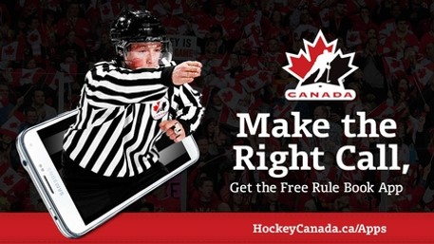
Re-Formatted Playing Rules

Slide 2
Overview
Part A – For all officials
Rule Changes (as approved at the AGM)

Slide 3
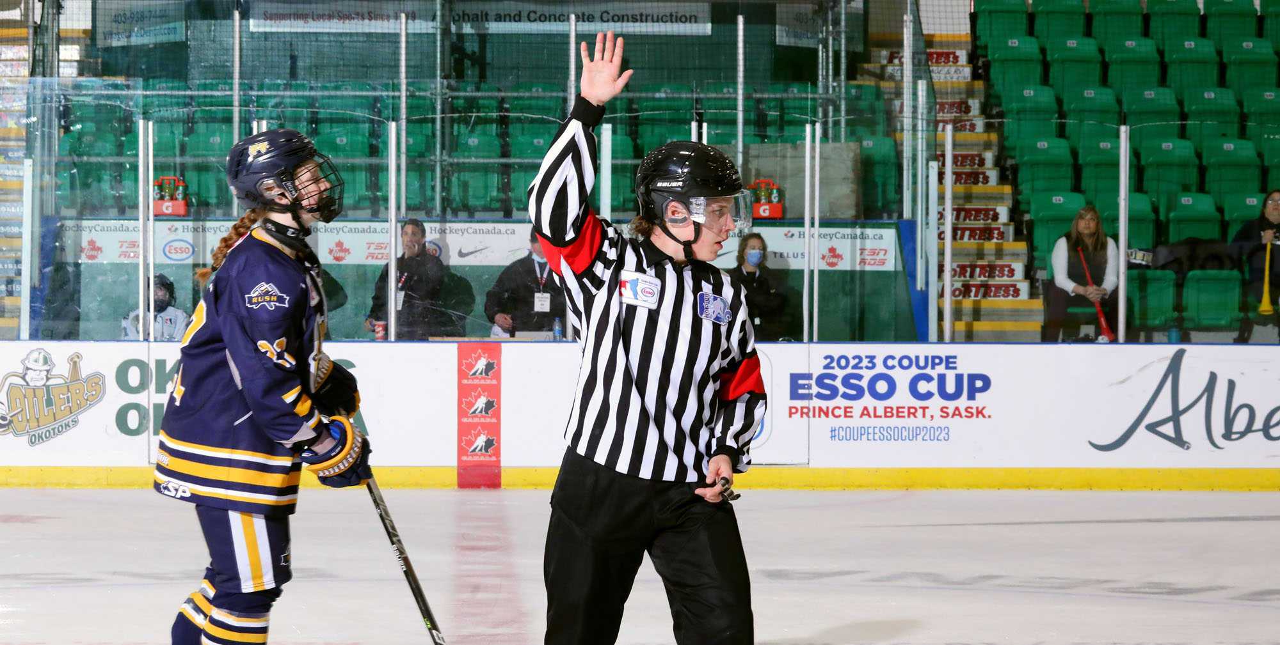
Part A Rule Changes for 2022-24

Slide 4
Rule Changes
The following changes to the Playing Rules were approved by the Members at the Hockey Canada Winter Congress (AGM).
ALL DIVISIONS OF HOCKEY
2.2 (k) | Players in Uniform
2.4 (d) | Injured Players
4.11 | Penalty Shots
6.3 (c) | Face-off location
6.7 (d) | Icing
6.7 (e) | Icing
6.18 | Time of Game
7.4 | Charging
8.7 | Clipping
9.1 | Butt-Ending
9.4 | Spearing
6.18 | Time of Game
JUNIOR A / SENIOR ONLY
4.6 | Coincidental Minor Penalties
6.4 | Face-off Location
6.5 | Face-off Violation

Slide 5
Rule 2.2 (k) – Players in Uniform
What Changed: A player who is injured can be on the bench during the game, but they must be listed as a player on the game report and they must wear the minimum protective equipment.
Note: This would not apply to suspended players, who may not be on the bench or listed on the game report.
New Text: In Minor and Female, a player that is duly registered to a team roster but unable to participate in a game due to injury may be permitted to take a position on the bench during the game, as long as they are included within the permitted players in uniform on the official game report and wearing the minimum equipment of a BNQ throat protector (minor and female), CSA approved Helmet and CSA facial protector; in accordance with the requirements for their registered category of play.

Slide 6
Rule 2.4 (k) – Injured Players
What Changed: Clarification that, if a team doesn’t have a goaltender dressed, a player can act as the goaltender for the penalty shot only, and then can return to acting as a skater.
New Text: Goaltender replacement shall be subject to the rules governing goaltenders and shall be allowed the goaltender’s full equipment. In divisions of U13 and below after a player has been designated as a goaltender, may return to a non-goaltender position. Only in divisions above U13, the player must remain as a goaltender once they have been designated as such. The only exception is when a team is awarded a penalty shot and the opposing team does not have a goaltender dressed.

Slide 7
Rule 4.11 – Penalty Shots
What Changed: When a team is awarded a Penalty Shot, any player on that team can take the shot.
Previously, it had to be the player who was fouled, or a player who was on the ice at the time of the infraction.
New Text: The coach/captain of the non-offending team may designate any player, other than the goaltender, to take the Penalty Shot. In the event that the coach/captain declines to select a player, the Referee will designate a player.

Slide 8
Rule 6.3 (c) – Face-off Location
What Changed: When a penalty is assessed, making a team shorthanded, the face-off will take place in the offending team’s defending zone, with five exceptions. This clarifies that premature substitution of the goaltender is one of those exceptions.
New Text: When this situation leads to a time penalty or multiple time penalties being placed on the penalty time clock to one team, making that team shorthanded, the ensuing face-off will be conducted at one of the two end zone face-off locations in the offending team’s defending zone. There are five exceptions:
(v) When play has been stopped due to a premature substitution of the goaltender. In this case, the face-off will take place at centre ice, except in cases where the offending team would gain a territorial advantage, in which case the face-off would take place at the nearest face-off location that does not provide that advantage.

Slide 9
Rule 6.18 (a) – Time of Game
What Changed: Clarification on the length of a standard game.
New Text: Three 20-minute periods of regulation playing time, with approximately a 10-minute intermission (when the ice is flooded) between each period, will be the maximum time allowed for each game.
Note: Members and Leagues may make their own rules regarding regulation time for games played under their jurisdiction, granted that it does not exceed the guidelines of this rule.

Slide 10
Rule 7.4 – Charging
What Changed: Addition of “blindside” hits as a criteria for a penalty under this rule.
New Text:
Charging is when a player:
Jumps to check an opponent.
Builds up speed by taking two or more strides immediately prior to making contact.
Travels an excessive distance with the sole purpose of delivering such a hit.
Violently and unnecessarily checks an opponent in any manner.
Delivers a body check to an opponent’s blind side.

Slide 11
Rule 8.7 – Clipping
What Changed: Addition of Clipping as an penalty, with a separate rule reference from Tripping. Clipping is where any player lowers their body to hit an opponent at or below the knees.
Note: This action was always illegal under the Playing Rules, but would previously have been penalized as Tripping.
New Text: Clipping, also known as a “low hit”, is where a player uses their body to make contact at or below an opponent’s knees. This may take the form of a player lowering their body prior to making a check or being checked. Players may not crouch down to avoid being bodychecked.

Slide 12
Rule 9.1 (c) – Butt-Ending
What Changed: Clarification that the referee may assess a Match penalty for Butt-Ending, based on the degree of violence and force of the action, even if no injury occurs.
New Text: (b) A Match penalty, at the discretion of the referee, based on the degree of violence of impact, may be assessed to any player who butt-ends or deliberately attempts to butt-end an opponent with force.
A Match penalty will be assessed to any player who injures an opponent by a butt-ending infraction that would otherwise call for a double Minor penalty.

Slide 13
Rule 9.4 (c) – Spearing
What Changed: Clarification that the referee may assess a Match penalty for Spearing, based on the degree of violence and force of the action, even if no injury occurs.
New Text: (c) A Match penalty will be assessed to any player or team official who deliberately spears or deliberately attempts to spear an opponent by jabbing them forcefully with the toe of the blade of the stick.
A Match penalty will be assessed to any player who injures an opponent by a spearing infraction that would otherwise call for a double Minor penalty.

Slide 14
Clarifications
Rule 3.6 (d) / Rule 10.6
Clarification that not wearing helmet, facial protector, or neck guard is penalized with a Minor penalty.
But the play should only be immediately stopped if the player participates in the play while not wearing a helmet or facial protector.
If a player participates in the play while not wearing a neck guard, it is a delayed penalty.
Improperly wearing a helmet, facial protector, or neck guard is a Misconduct penalty, which would be a delayed penalty.

Slide 15
Clarifications
Rule 3.7
Clarification that the Referee has the authority to remove any piece of non-standard equipment from the game that “provides an undue advantage to the user in playing of the game or that poses a danger to the user or other participants.”
This would follow the same procedure for any other piece of equipment deemed “dangerous”.

Slide 16
Clarifications
Rule 4.8 / 4.9 / 4.10
Clarification that when a player is removed from the game because of a Game Ejection, Game Misconduct, Gross Misconduct, or Match penalty, they do not have to stay physically in the dressing room, provided that they do not interact with the game or the participants in any matter.

Slide 17
Clarifications
Rule 4.12
Simplification of the text of the rule, regarding when a goal may be awarded, in reference to Rule 4.11 – Penalty Shots.
Removal of distinction on the awarding of a goal based on possession of the puck versus after the puck has been shot. This distinction was creating confusion and was deemed unnecessary and counter to the spirit of the rule.

Slide 18
Clarifications
Rule 6.2
Clarification that all players on the ice must be standing still while a face-off is occurring.
6.2 is a new rule reference that specifically deals with actually conducting a face-off. However, there are not any meaningful changes to the rule.

Slide 19
Clarifications
Rule 6.3
A new rule reference that addresses everything to do with the location of a face-off. However, there are not any meaningful changes to the rule.

Slide 20
Clarifications
Rule 6.9 / 6.10
Clarification that the height of the crossbar (as it pertains to high-sticking the puck) on a goal or no-goal situation applies ONLY in Junior A (Rule 6.10)
In Minor and Female hockey, the only criteria for high-sticking the puck is the normal height of the shoulders (Rule 6.9)

Slide 21
Clarifications
Rule 7.7
A new rule reference for Head Contact in Junior A and Senior divisions only.
This rule incorporates guidance that was previously found in the appendix, “Clarifications for Junior A & Senior Hockey”.
Officials who work Junior A or Senior divisions should review this information to ensure they are accurately applying this rule.

Slide 22
Clarifications
Rule 7.9 / 7.10 / 7.11
The former rule “Fighting and Roughing” is now three separate rule references:
Rule 7.9 – Roughing
Rule 7.10 – Fighting
Rule 7.11 – Instigator & Aggressor
There should not be any rule changes, but this is an opportunity for officials to review, to ensure they understand and are correctly applying the rule.

Slide 23
Clarifications
Rule 8.3 / 8.4 / 8.5
The former rule “Interference” is now three separate rule references:
Rule 8.3 – Interference
Rule 8.4 – Interference from the Bench
Rule 8.5 – Interference with the Goaltender
This includes clarified language on players in the crease and goal/no-goal situations

Slide 24
Clarifications
Rule 10.3
Additional language and definitions around diving and embellishment (both of which should be penalized) but no rule changes.

Slide 25
Clarifications
Rule 10.6
New rule reference for “Illegal Equipment”
Please note that this rule reference replaces certain ‘one-off’ infractions that were previously referenced:
E.g. “Ineligible Player” for participating in the play without protective equipment, “Carrying Two Hockey Sticks”, “Illegally Receiving a Stick”
This rule also covers undoing a chinstrap or removing a helmet to fight

